Slide 1





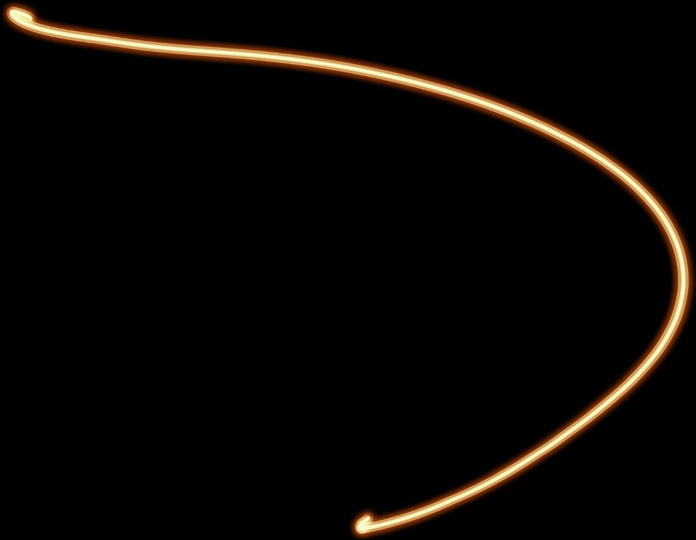



INTRODUCTION TO FLUID SIMULATIONS
SVEN JANUSCH

Slide 2
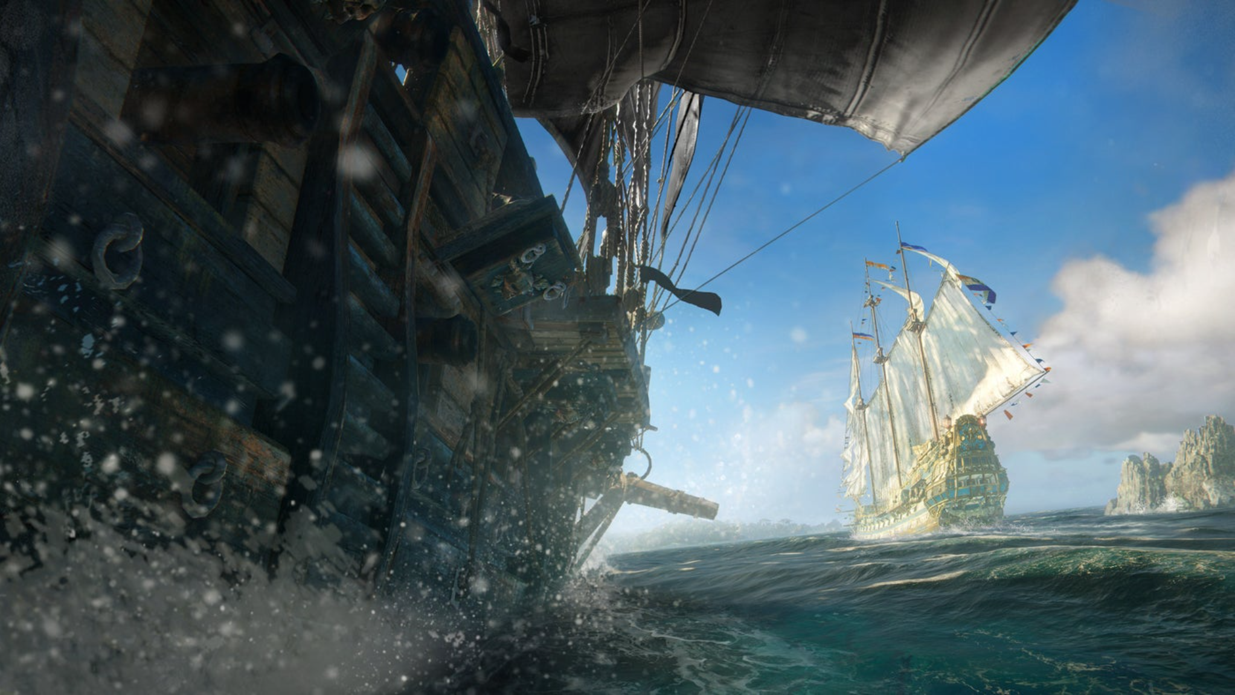
BREAKDOWN
Generation
Physical Simulation
Interaction with Environment
Empirical Simulation
Breaking Waves
Foam
Blending
Rendering
Scattering
Absorbtion
Refraction
Reflection
Caustics
Foam
Wetness
Particles
Physics
Objects interact with water
Query water height/normal
Skull & Bones
Notes:
Before I show the Agenda, let‘s have a breakdown of water rendering in games.
Fill focus on physical simulation, interaction with the environment and blending.

Slide 3
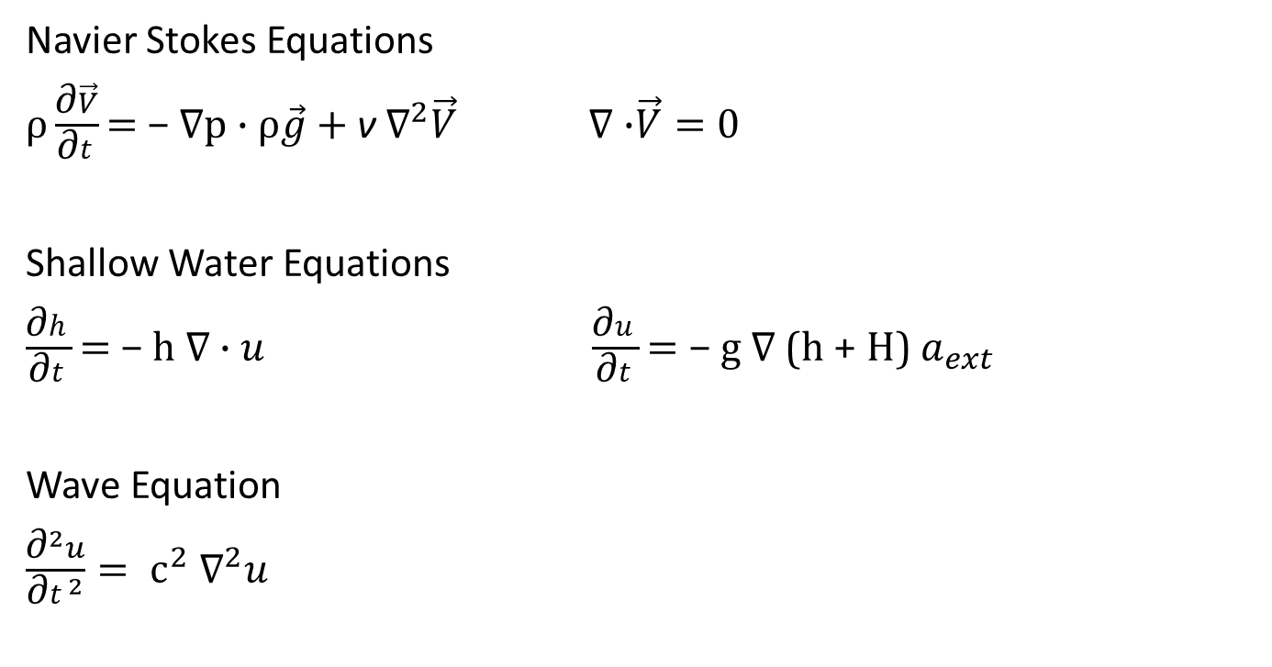
PHYSICAL SIMULATIONS
Navier Stokes Equations
$ρ\frac{\text{∂}\vec{V}}{\text{∂}t}\text{= }\text{− }\text{∇}\text{p}\text{ ·} ρ\vec{g}+$ν ${\text{∇}}^{2}\vec{V} \text{∇}\text{ ·}\vec{V}=0$
Shallow Water Equations
$\frac{\text{∂}h}{\text{∂}t}\text{= }\text{− }\text{h} \text{∇}\text{ · }u$ $\frac{\text{∂}u}{\text{∂}t}\text{= }\text{− }\text{g} \text{∇}\text{ (}\text{h}\text{ + }\text{H}\text{) }a_{ext}$
Wave Equation
$\frac{{\text{∂}}^{2}u}{{\text{∂}t}^{2}}= {\text{c}}^{2} {\text{∇}}^{2}u$
Notes:
The Navier-Stokes equation is a fundamental partial differential equation in fluid dynamics, expressing the conservation of momentum for a fluid, including the effects of viscosity and external forces. It expresses the conservation of momentum + mass for the second equation
$\vec{V}$ is the velocity vector field
ρ is the fluid density
p is the pressure field
ν is the kinematic viscosity of the fluid
g is gravity
The shallow water equations are derived from the Navier-Stokes equations under assumptions of negligible vertical motion and hydrostatic pressure. Describe the dynamics of shallow water waves, comprising a continuity equation for water depth conservation and a momentum equation governing water flow velocity.
Wave Equation can be derived from the Navier Stokes Equation
Shallow water can drastically affect the boundaries of a liquid while wave equation will "just" propagate some waves on the surface.
Goal of this presentation is that everyone can understand these equations.
Today we will just focus on the Wave Equation.
But we will learn to read and understand this equations and after that we will learn how to approximate the wave equation.

Slide 4
AGENDA
Scalar & Vector Fields
01
Theory
02
Partial Derivatives
Gradient & Divergence & Laplace
03
Wave Equation
04
Approximate derivatives
05
Practice
06
Numerical Integration
Interaction
07
Blending
08
Q&A
09
Notes:
The presentation is split in two parts:
1st part is teaching the math fundamentals to understand the wave equation
2nd part is teaching how to approximate these to be able to execute it in real-time

Slide 5
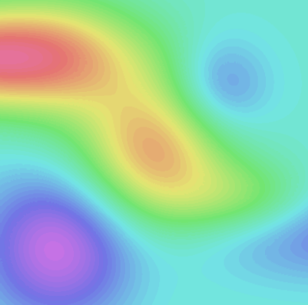

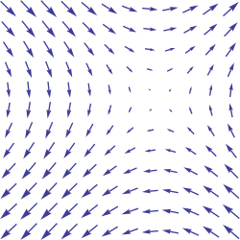
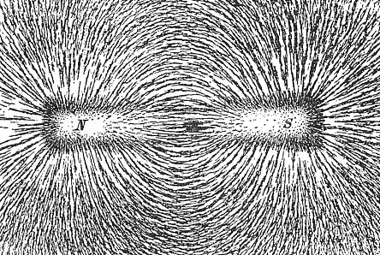


SCALAR & VECTOR FIELDS
SCALAR FIELD
VECTOR FIELD
Assigns a number (scalar) to every point P in space U = U(P)
Temperature Field, Pressure Field, Density Field, Height Field
Assigns a vector to every point P in space $\vec{V}$ = $\vec{V}$ (P)
Gradient Field, Velocity Field, Flow Field, Magnetic Field
[13]
[14]
[15]
Notes:
Scalar & vector fields are also called scalar functions and vector functions
Discretize by arrays, textures, …

Slide 6
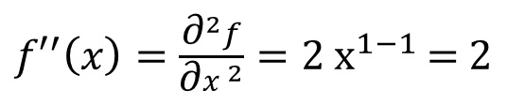
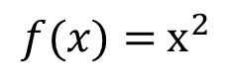
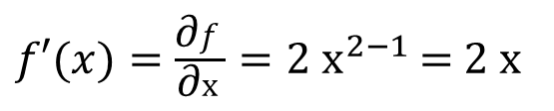
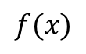
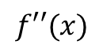
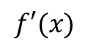
DERIVATIVES
Derivative quantifies the rate of change of a function
In other words, the slope of the local tangent
$f′(x)=\frac{\text{∂}f}{\text{∂}x}=2{ x}^{2−1}$ = 2 x
${f′}^{′}\left(x\right)=\frac{{\text{∂}}^{2}f}{{\text{∂}x}^{2}}=2{ x}^{1−1}$ = 2
$$f(x)={ x}^{2}$$
$$f(x)$$
$$f′(x)$$
$$f′′(x)$$
x
x
x
Notes:
Small reminder.
Leibniz notation: Represented as the ratio of two differentials (dy/dx).

Slide 7
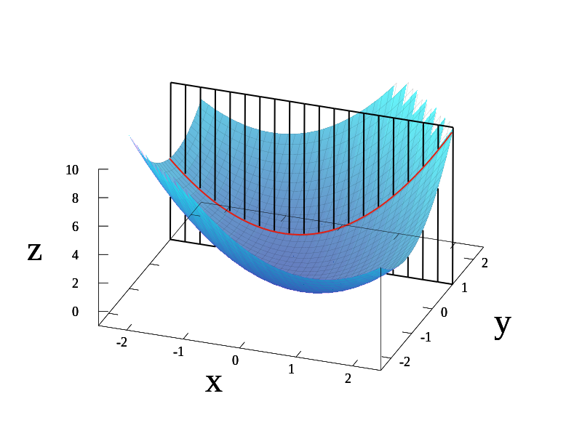
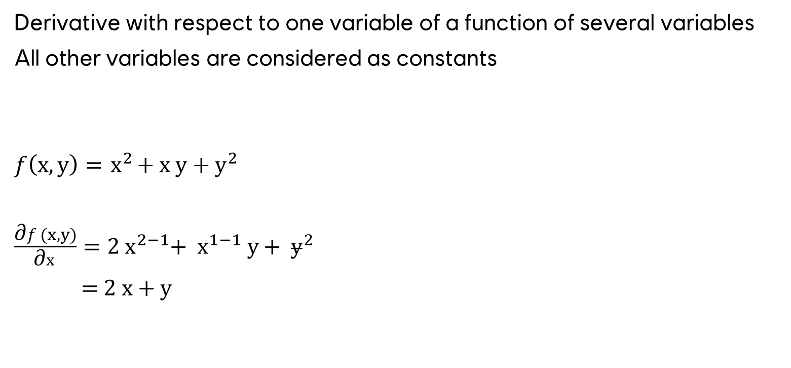
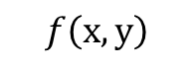
PARTIAL DERIVATIVES
Derivative with respect to one variable of a function of several variables
All other variables are considered as constants
$f\left(x,y\right)={ x}^{2}+ x y+{ y}^{2}$
$\frac{\text{∂}f(x,y)}{\text{∂}x}=2{ x}^{2−1}$+ ${ x}^{1−1} y+$ ${ y}^{2}$
= 2 x + y
$$f\left(x,y\right)$$
[1]
Notes:
Image:
A graph of z = x² + xy + y².
For the partial derivative at (1, 1) that leaves y constant, the corresponding tangent line is parallel to the xz-plane.
The slope is 3 at (1, 1).

Slide 8
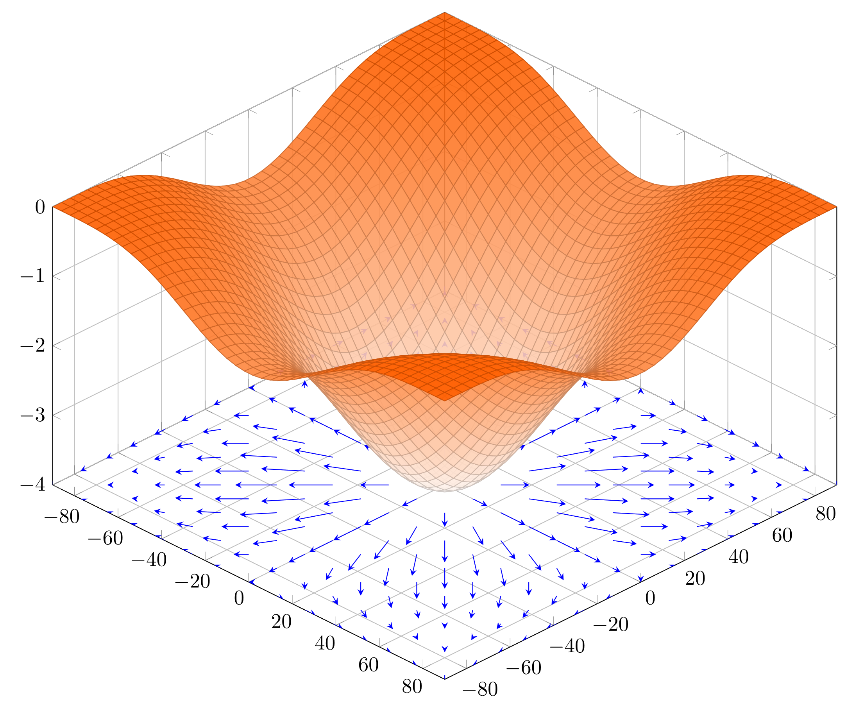
GRADIENT
The gradient of a scalar field U assigns every point P a gradient vector
The direction of gradient is always perpendicular to the direction of the level surface U = const
grad U points always into the direction in which the function U is increasing
The magnitude of grad U is equal to the directional derivative of U in the normal direction
2D function with a 2D gradient!
Level Surface is not a circle!
[2]

Slide 9
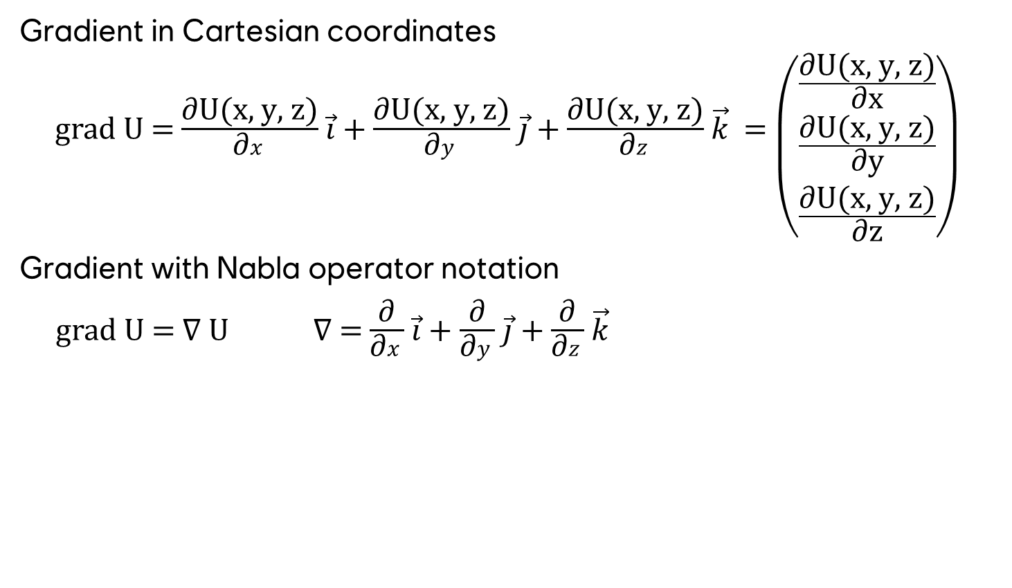
GRADIENT
Gradient in Cartesian coordinates
grad U = $\frac{\text{∂}\text{U}\text{(}\text{x}\text{, }\text{y}\text{, }\text{z}\text{)}}{\text{∂}x}$ $\vec{i}$ + $\frac{\text{∂}\text{U}\text{(}\text{x}\text{, }\text{y}\text{, }\text{z}\text{)}}{\text{∂}y}$ $\vec{j}$ + $\frac{\text{∂}\text{U}\text{(}\text{x}\text{, }\text{y}\text{, }\text{z}\text{)}}{\text{∂}z}$ $\vec{k}$ = $\left({\frac{\text{∂}\text{U}\text{(}\text{x}\text{, }\text{y}\text{, }\text{z}\text{)}}{\text{∂}\text{x}} \atop \begin{aligned}\frac{\text{∂}\text{U}\text{(}\text{x}\text{, }\text{y}\text{, }\text{z}\text{)}}{\text{∂}\text{y}} \\ \frac{\text{∂}\text{U}\text{(}\text{x}\text{, }\text{y}\text{, }\text{z}\text{)}}{\text{∂}\text{z}}\end{aligned}}\right)$
Gradient with Nabla operator notation
grad U = ∇ U ∇ = $\frac{\text{∂}}{\text{∂}x}$ $\vec{i}$ + $\frac{\text{∂}}{\text{∂}y}$ $\vec{j}$ + $\frac{\text{∂}}{\text{∂}z}$ $\vec{k}$
Notes:
Reminder, the symbol ∂/∂x means partial differentiation with respect to x
Vector Gradient exist, result is a matrix
Nabla Operator is not equal to the gradient! Nable operator is a symbolic vector.

Slide 10
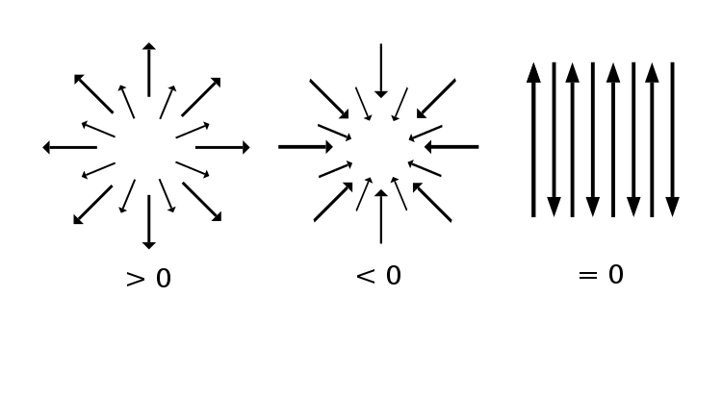
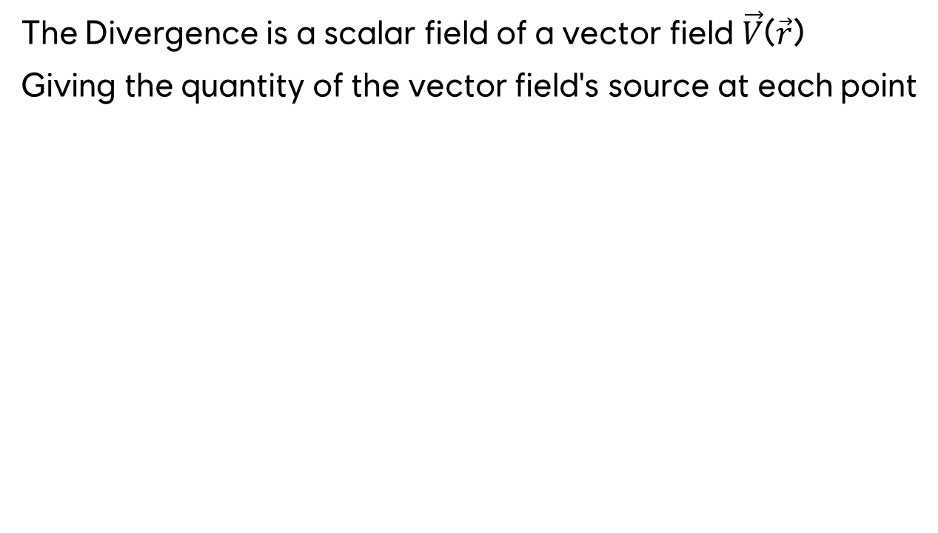
DIVERGENCE
The Divergence is a scalar field of a vector field $\vec{V}$($\vec{\text{r}}$)
Giving the quantity of the vector field's source at each point
[3]
Notes:
div=0 implies that, flow that goes in is equal ot flow that goes out.
From the Navier Stokes Equation: ∇ · $\vec{V}=0$ || ∇ · u $=0$
This equation represents the conservation of mass, it says that the divergence of the velocity vector field is zero.

Slide 11
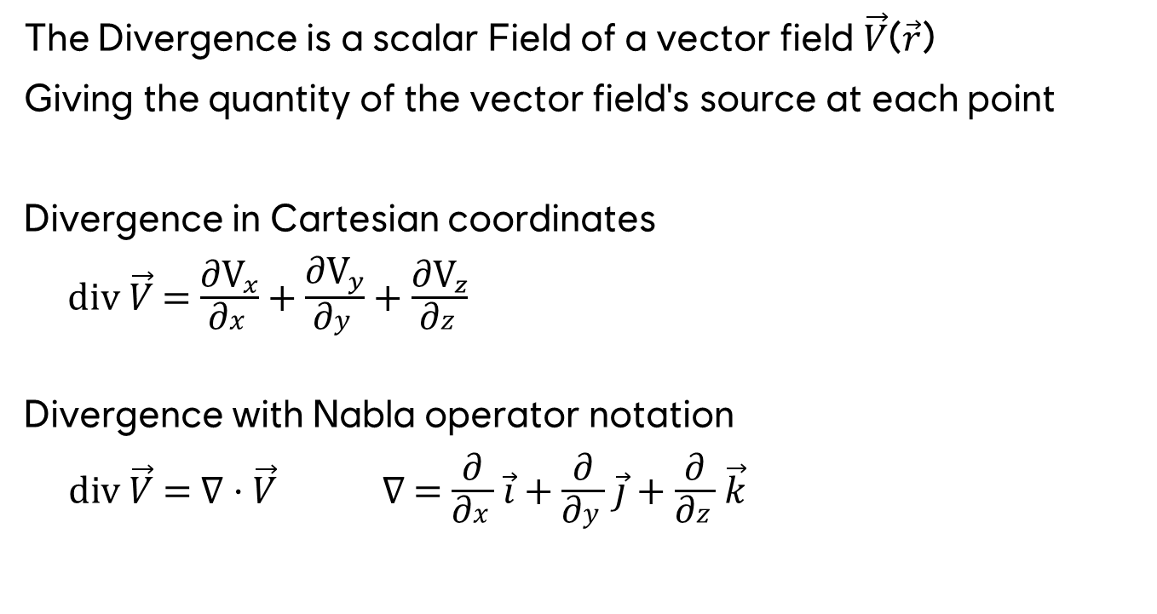
DIVERGENCE
The Divergence is a scalar Field of a vector field $\vec{V}$($\vec{\text{r}}$)
Giving the quantity of the vector field's source at each point
Divergence in Cartesian coordinates
d$iv \vec{V}$ = $\frac{\text{∂}{\text{V}}_{x}}{\text{∂}x}$ + $\frac{\text{∂}{\text{V}}_{y}}{\text{∂}y}$ + $\frac{\text{∂}{\text{V}}_{z}}{\text{∂}z}$
Divergence with Nabla operator notation
div $\vec{V}$ = ∇ · $\vec{V}$ ∇ = $\frac{\text{∂}}{\text{∂}x}$ $\vec{i}$ + $\frac{\text{∂}}{\text{∂}y}$ $\vec{j}$ + $\frac{\text{∂}}{\text{∂}z}$ $\vec{k}$
Notes:
Scalar product between the Nabla operator and the Vector Field.

Slide 12
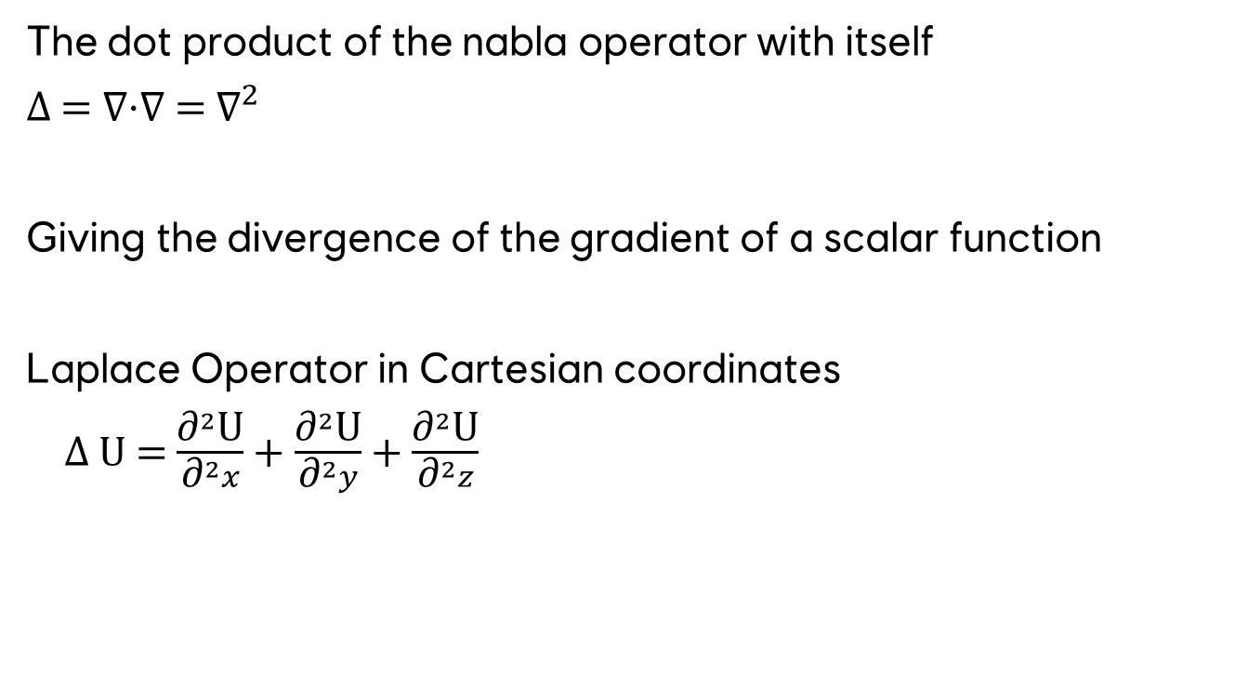
LAPLACE OPERATOR
The dot product of the nabla operator with itself
Δ = ∇·∇ = ${\text{∇}}^{2}$
Giving the divergence of the gradient of a scalar function
Laplace Operator in Cartesian coordinates
Δ U = $\frac{{\text{∂}}^{2}\text{U}}{{\text{∂}}^{2}x}$ + $\frac{{\text{∂}}^{2}\text{U}}{{\text{∂}}^{2}y}$ + $\frac{{\text{∂}}^{2}\text{U}}{{\text{∂}}^{2}z}$
Notes:
It prescribes the summation of the second partial derivatives
The Laplace operator is not a vector
Invariant: It does not change during translation and/or rotation of the coordinate system.
Can be applied to scalar functions as well as to vector functions.
The application to a vector function, component-wise, results in a vector.
Often uses ${\text{∇}}^{2}$ notation to avoid confusion with delta.

Slide 13
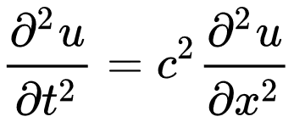
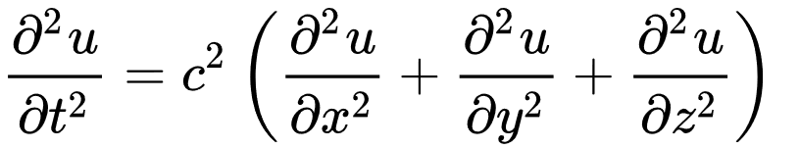
WAVE EQUATION
Discovered by Jean-Baptiste le Rond d‘Alembert (1717 ~ 1783)
Can be derived from the Navier Stokes Equation
u represents the height of water
t represents the time
x represents the position
c is constant non-negative real coefficient and represents the speed of the wave
Notes:
This equation is typically described as having only one space dimension x, because the only other independent variable is the time t. Nevertheless, the dependent variable u may represent a second space dimension, if, for example, the displacement u takes place in y direction, as in the case of a string that is located in the xy plane.
This equation is a partial differential equation and describes how the wave's displacement changes with both time and position. The wave equation can be adapted to different situations depending on the specific characteristics of the wave and the medium through which it propagates. Geometrically, it describes the curvature or the rate at which the wave is bending at a specific point in space. It tells us how the displacement of the wave changes concerning the position along the medium.
The wave equation essentially states that the acceleration of the wave at any point in time and space is proportional to the curvature of the wave at that point, with the constant of proportionality being c2. This relationship is fundamental to understanding how waves propagate through different media.

Slide 14
WAVE EQUATION
Discovered by Jean-Baptiste le Rond d'Alembert (1717 ~ 1783)
Can be derived from the Navier Stokes Equation
Left side is the second partial derivative of u with respect to time, representing the acceleration of the wave
Right side is the second partial derivative of u with respect to position, representing the change of curvature of the wave
Notes:
In other words, the acceleration of the wave is based on the change of change of the wave height.

Slide 15
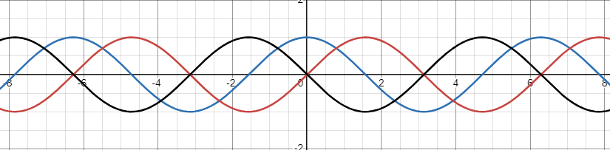
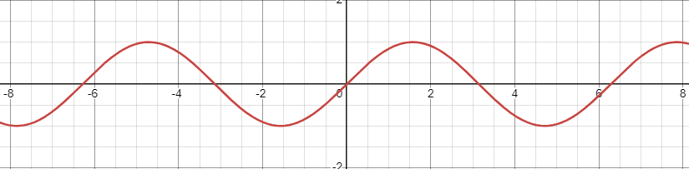
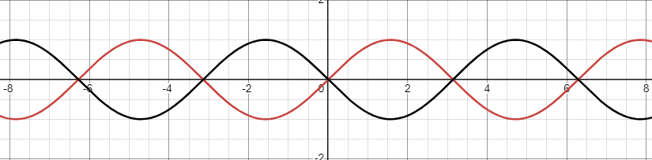
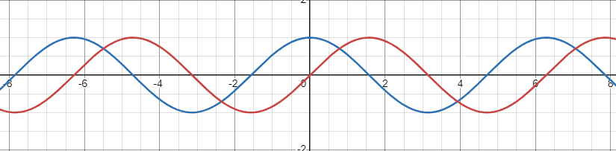



WAVE EQUATION
Discovered by Jean-Baptiste le Rond d'Alembert (1717 ~ 1783)
Can be derived from the Navier Stokes Equation
$$f\left(x\right)=sin⁡(x)$$
$$f^{′}\left(x\right)=cos⁡(x)$$
$$f^{′′}\left(x\right)=−sin⁡(x)$$
Notes:
In other words, the acceleration of the wave is based on the change of change of the wave height.

Slide 16


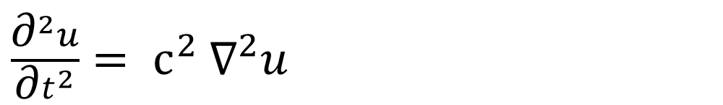
WAVE EQUATION
Discovered by Jean-Baptiste le Rond d'Alembert (1717 ~ 1783)
Can be derived from the Navier Stokes Equation
Newton notation by using the Laplace Operator
$\frac{{\text{∂}}^{2}u}{{\text{∂}t}^{2}}= {\text{c}}^{2} {\text{∇}}^{2}u$

Slide 17
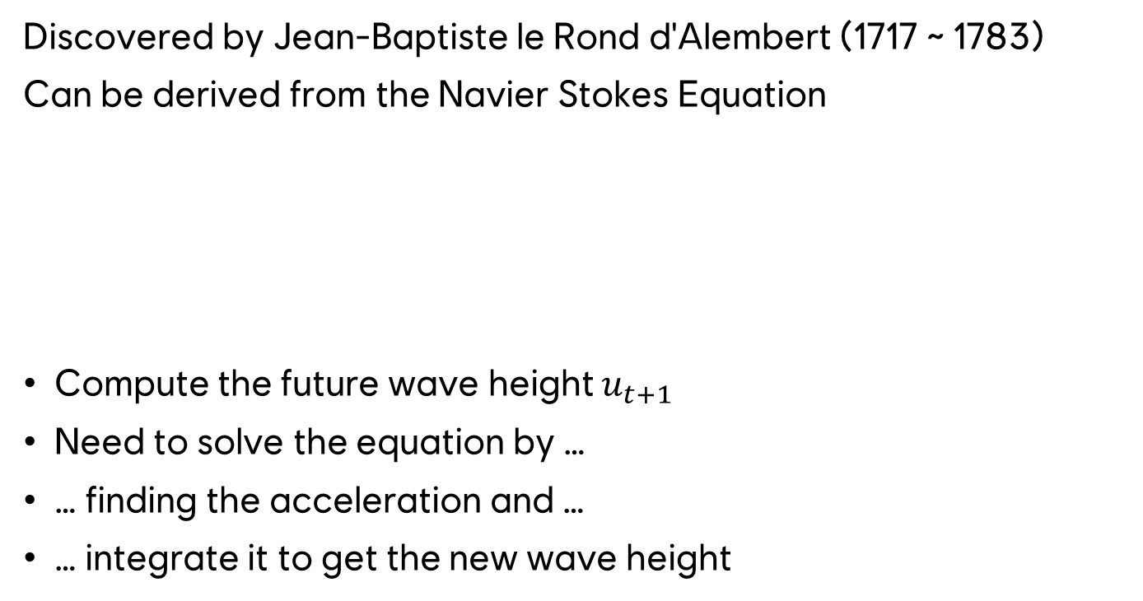
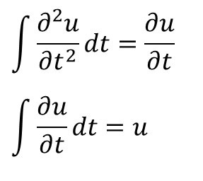
WAVE EQUATION
Discovered by Jean-Baptiste le Rond d'Alembert (1717 ~ 1783)
Can be derived from the Navier Stokes Equation
Compute the future wave height $u_{t+1}$
Need to solve the equation by …
… finding the acceleration and …
… integrate it to get the new wave height
$$\int{\frac{{\text{∂}}^{2}u}{{\text{∂}t}^{2}}}dt=\frac{\text{∂}u}{\text{∂}t}$$
$$\int{\frac{\text{∂}u}{\text{∂}t}}dt=u$$
Notes:
In other words, the acceleration of the wave is based on the curvature of the wave.

Slide 18
HOW TO SIMULATE?
Euler
Lagrange
Fluid motion that focuses on specific locations in the space through which the fluid flows as time passes
Using grids/textures
Fluid motion that follows an individual fluid parcel as it moves through space and time
Deals with individual particles and calculates the trajectory of each particle separately
Notes:
Hybrid methods are also existing. Semi-Lagrangian schemes use a regular (Eulerian) grid, just like finite difference methods. The idea is this: at every time step the point where a parcel originated from is calculated. An interpolation scheme is then utilized to estimate the value of the dependent variable at the grid points surrounding the point where the particle originated from. Famous example is the so called FLIP solver.
https://mechcontent.com/lagrangian-vs-eulerian-difference/

Slide 19
HOW TO SIMULATE?
Euler
Fluid motion that focuses on specific locations in the space through which the fluid flows as time passes
Using grids/textures
2D Heightmap represents 𝑢
0.7
1.1
0.8
0.3
0.8
0.6
1.1
0.4
0.5
Notes:
In our case we will use a Eulerian approach. In other words, in our case a scalar field is be represented by an heightmap.

Slide 20
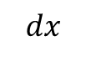
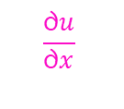
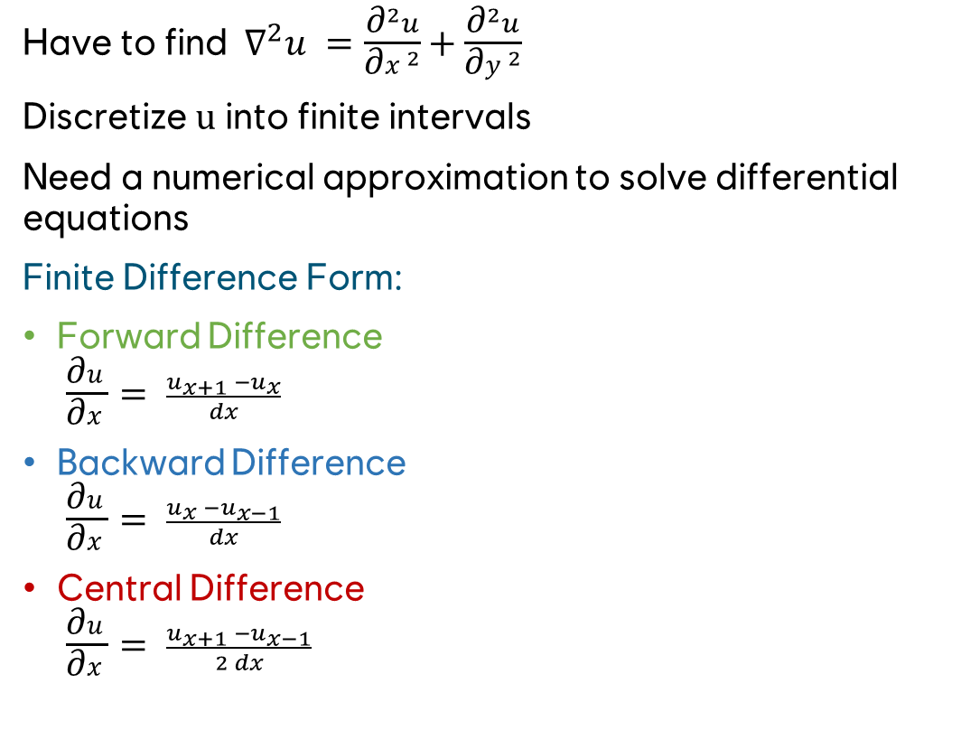
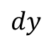
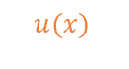



FIND THE ACCELERATION
Have to find ${ \text{∇}}^{2}u =\frac{{\text{∂}}^{2}u}{{\text{∂}x}^{2}}$ + $\frac{{\text{∂}}^{2}u}{{\text{∂}y}^{2}}$
Discretize u into finite intervals
Need a numerical approximation to solve differential equations
Finite Difference Form:
Forward Difference $\frac{\text{∂}u}{\text{∂}x}= \frac{u_{x+1} −u_{x}}{dx}$
Backward Difference $\frac{\text{∂}u}{\text{∂}x}= \frac{u_{x} −u_{x−1}}{dx}$
Central Difference $\frac{\text{∂}u}{\text{∂}x}= \frac{u_{x+1} −u_{x−1}}{2 dx}$
$$dy$$
$$\frac{\text{∂}u}{\text{∂}x}$$
$$u(x)$$
$$u_{x−1}$$
$$u_{x }$$
$$u_{x+1}$$
$$dx$$
Notes:
Reminder we need to find the acceleration, which is based on ${ \text{∇}}^{2}u$
The finite difference form is a numerical approximation method used to solve differential equations by discretizing them into finite intervals. It involves replacing derivatives with finite difference approximations, making the equations solvable using simple algorithms.
Three basic types for finit difference form.

Slide 21

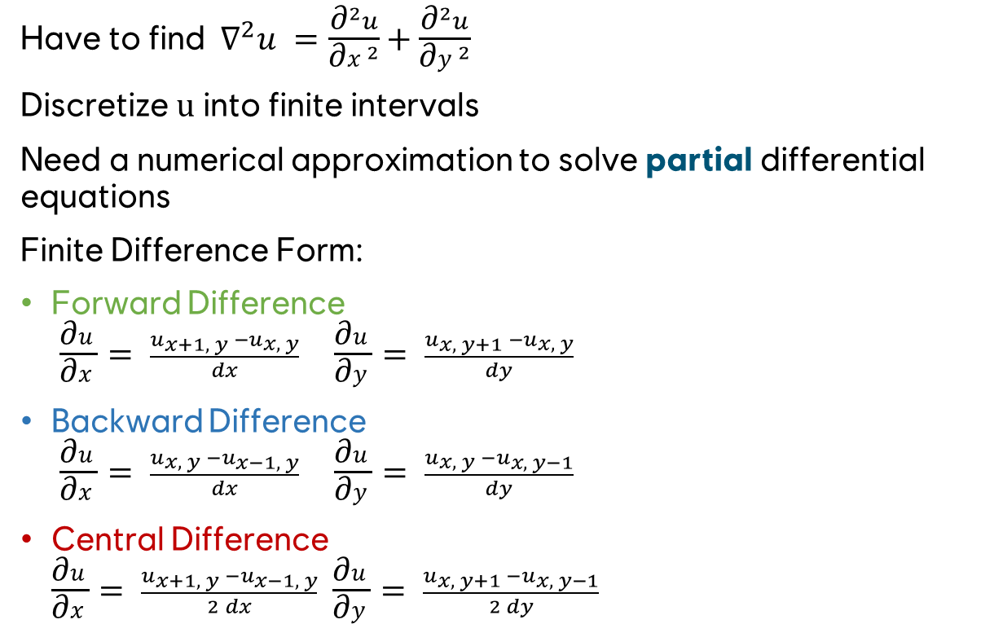


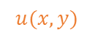
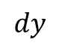


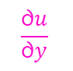
FIND THE ACCELERATION
Have to find ${ \text{∇}}^{2}u =\frac{{\text{∂}}^{2}u}{{\text{∂}x}^{2}}$ + $\frac{{\text{∂}}^{2}u}{{\text{∂}y}^{2}}$
Discretize u into finite intervals
Need a numerical approximation to solve partial differential equations
Finite Difference Form:
Forward Difference $\frac{\text{∂}u}{\text{∂}x}= \frac{u_{x+1, y} −u_{x, y}}{dx} \frac{\text{∂}u}{\text{∂}y}= \frac{u_{x, y+1} −u_{x, y}}{dy}$
Backward Difference $\frac{\text{∂}u}{\text{∂}x}= \frac{u_{x, y} −u_{x−1, y}}{dx} \frac{\text{∂}u}{\text{∂}y}= \frac{u_{x, y} −u_{x, y−1}}{dy}$
Central Difference $\frac{\text{∂}u}{\text{∂}x}= \frac{u_{x+1, y} −u_{x−1, y}}{2 dx}$ $\frac{\text{∂}u}{\text{∂}y}= \frac{u_{x, y+1} −u_{x, y−1}}{2 dy}$
$$\frac{\text{∂}u}{\text{∂}y}$$
$$u(x,y)$$
$$u_{x, y−1}$$
$$u_{x−1, y}$$
$$u_{x, y }$$
$$u_{x+1, y}$$
$$dy$$
$$u_{x, y+1}$$
Notes:
Important to mention is that the central difference approach does not consider $u_{x, y}$the height of the point itself, which can be problematic in some the scenarios, e.g. a high frequency change at one point.
Despite this fact, central difference has usually the lowest error values.

Slide 22
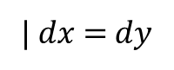
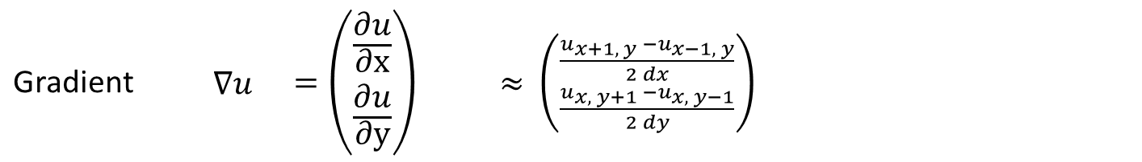
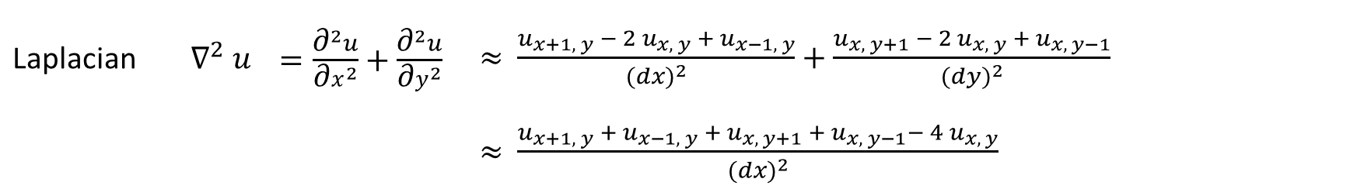
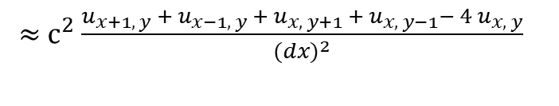
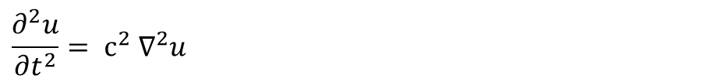
Central Difference: 1st Partial Derivative | $\frac{\text{∂}u}{\text{∂}x} = \frac{u_{x+1, y} −u_{x−1, y}}{2 dx}$ $\frac{\text{∂}u}{\text{∂}y} = \frac{u_{x, y+1} −u_{x, y−1}}{2 dy}$
$$\text{Central} \text{Difference}\text{: 2}\text{nd} \text{Partial} \text{Derivative}$$ | $$\frac{{\text{∂}}^{2}u}{{\text{∂}x}^{2}}= \frac{u_{x+1, y} −{ 2 u}_{x, y} + u_{x−1, y}}{{(dx)}^{2}} \frac{{\text{∂}}^{2}u}{{\text{∂}y}^{2}}= \frac{u_{x, y+1} −{ 2 u}_{x, y} + u_{x, y−1}}{{(dy)}^{2}}$$
Gradient | ∇$u$ | $$=\left({\frac{\text{∂}u}{\text{∂}\text{x}} \atop \frac{\text{∂}u}{\text{∂}\text{y}}}\right)$$ | ≈ $\left({\frac{u_{x+1, y} −u_{x−1, y}}{2 dx} \atop \frac{u_{x, y+1} −u_{x, y−1}}{2 dy}}\right)$
Divergence | ∇ · $\vec{V}$ | $=\frac{\text{∂}{\vec{V}}_{x }}{\text{∂}\text{x}}$ + $\frac{\text{∂}{\vec{V}}_{y }}{\text{∂}y}$ | ≈ $\frac{{\vec{V}}_{x_{x+1, y}}−{\vec{V}}_{x_{x−1, y}}}{2 dx}$ + $\frac{{\vec{V}}_{y_{x, y+1}}−{\vec{V}}_{y_{y, y−1}}}{2 dy}$
Laplacian | $${\text{∇}}^{2} u$$ | $=\frac{{\text{∂}}^{2}u}{{\text{∂}x}^{2}}$ + $\frac{{\text{∂}}^{2}u}{{\text{∂}y}^{2}}$ | ≈ $\frac{u_{x+1, y} −{ 2 u}_{x, y} + u_{x−1, y}}{{(dx)}^{2}}$ + $\frac{u_{x, y+1} −{ 2 u}_{x, y} + u_{x, y−1}}{{(dy)}^{2}}$
 |  |  | ≈ $\frac{u_{x+1, y} + u_{x−1, y}{ + u}_{x, y+1} + u_{x, y−1}−{ 4 u}_{x, y}}{{(dx)}^{2}}$
| $dx$ = $dy$
$$\frac{{\text{∂}}^{2}u}{{\text{∂}t}^{2}}= {\text{c}}^{2} {\text{∇}}^{2}u$$
≈ ${\text{c}}^{2}$ $\frac{u_{x+1, y} + u_{x−1, y}{ + u}_{x, y+1} + u_{x, y−1}−{ 4 u}_{x, y}}{{(dx)}^{2}}$
https://en.wikipedia.org/wiki/Five-point_stencil
Notes:
All approximations require only the sampling of the N4 neighbor pixels and the center pixels.

Slide 23
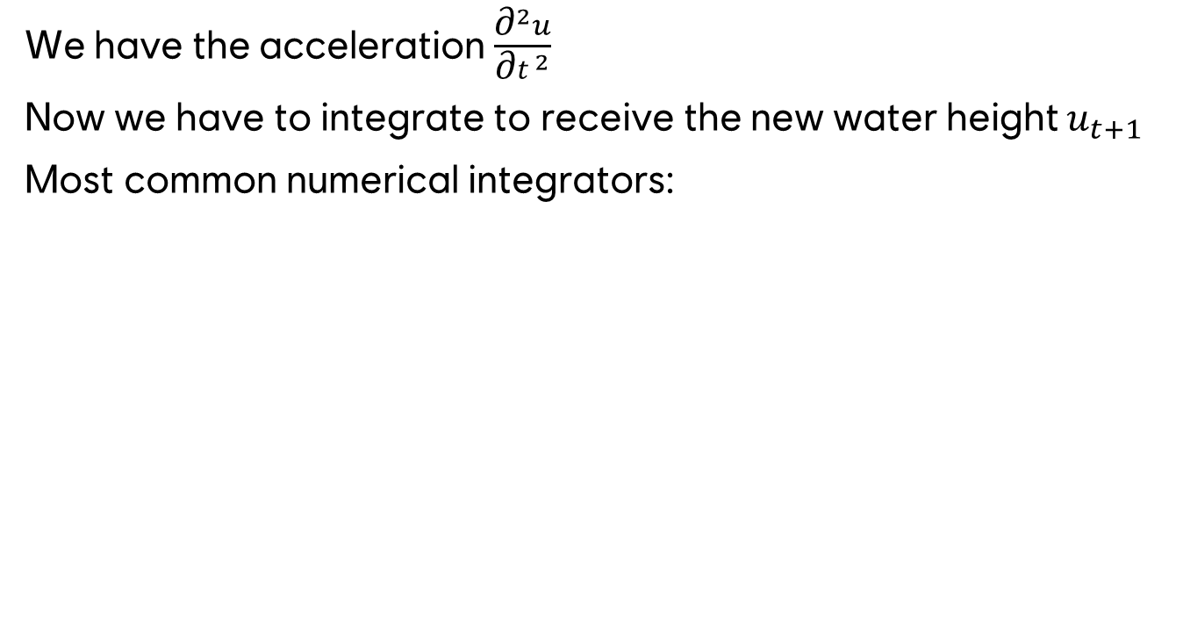
INTEGRATION
We have the acceleration $\frac{{\text{∂}}^{2}u}{{\text{∂}t}^{2}}$
Now we have to integrate to receive the new water height $u_{t+1}$
Most common numerical integrators:ssig
Euler
Verlet
Mid-Point
Runga-Kutta
Notes:
All the methods have different advantages/disadvantages: Performance, Stability, Error, Preservation/Conservation of Energy...
Jean Baptiste Joseph Delambre can be easily misunderstood with Jean-Baptiste le Rond d'Alembert

Slide 24
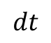
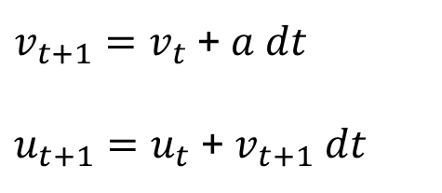
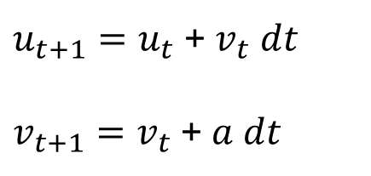
EULER INTEGRATION
Discretize the time
In other words, having fixed time steps dt in our simulation
Simple approximation could be:
Gains energy and is not accurate
Loses slightly energy and is more accurate
$u_{t+1}=u_{t}$ + $v_{t} dt$
$v_{t+1}=v_{t}$ + $a dt$
Explicit Euler Integration
u
$v_{t+1}=v_{t}$ + $a dt$
$u_{t+1}=u_{t}$ + $v_{t+1} dt$
Only symbolizing, not real
computed integration!
Semi implicit Euler Integration
t
t+1
t+2
t+3
t+4
t+5
t+6
t
$$dt$$
Notes:
Discovered by Leonhard Euler (1707 ~ 1783).
Important: velocity in u direction, not xy!
The bigger the time step the bigger the error.

Slide 25
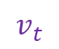
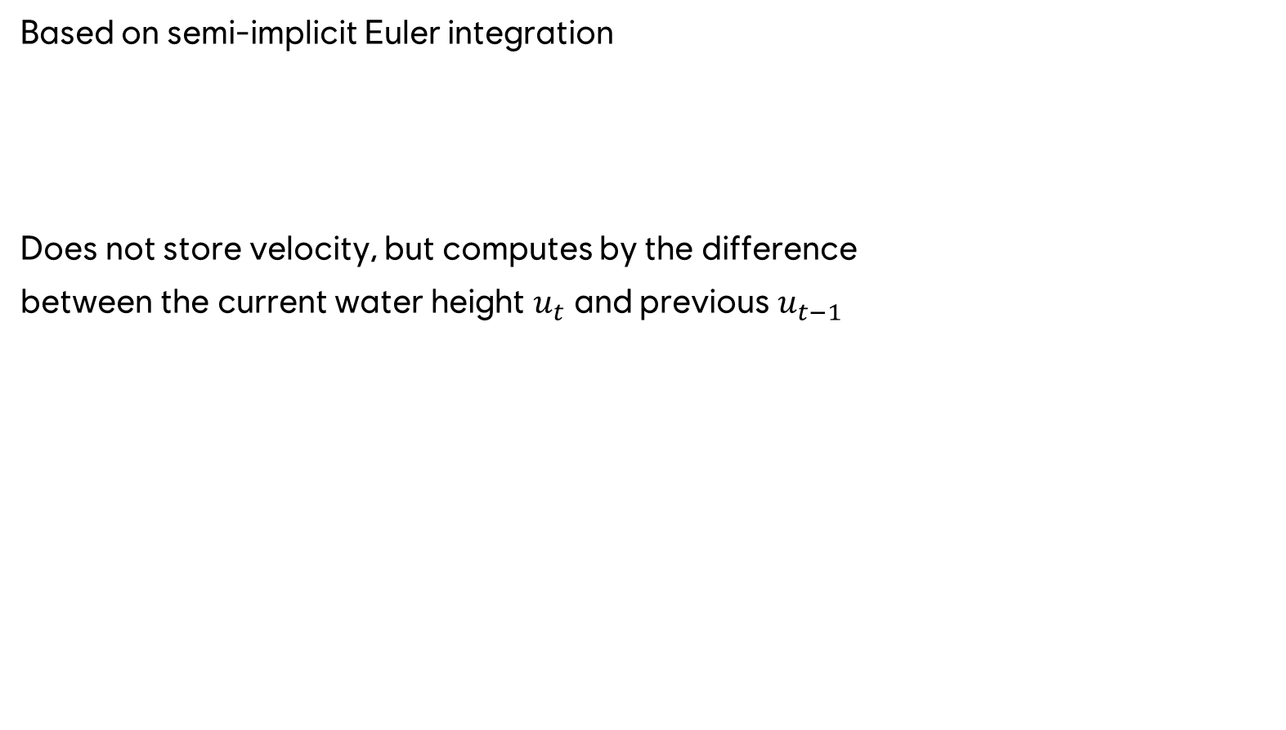



VERLET INTEGRATION
Based on semi-implicit Euler integration
Does not store velocity, but computes by the difference
between the current water height $u_{t}$ and previous $u_{t−1}$
$v_{t+1}=v_{t}$ + $a dt$
$u_{t+1}=u_{t}$ + $v_{t+1} dt$
Semi-implicit Euler Integration
u
$v_{t}=\frac{u_{t}\text{ − }u_{t−1}}{dt}$
$u_{t+1}=u_{t}$ + $v_{t+1} dt$
$=u_{t}$ + $(v_{t}\text{ + }a dt) dt$
= $u_{t}$ + $v_{t} dt+a {dt}^{2}$
= $u_{t}$ + $\frac{u_{t}\text{ − }u_{t−1}}{dt} dt+a {dt}^{2}$
= $u_{t}$ +${ u}_{t}\text{ − }u_{t−1}+a {dt}^{2}$
$$v_{t}$$
$$v_{t+1}$$
t-1
t
t+1
t
Notes:
Discovered by Jean Baptiste Joseph Delambre (1749 ~ 1822)
Rediscovered amongst others by Loup Verlet (1931 ~ 2019)
$u_{t}=u_{t−1}$ + $v_{t} dt$ rearranging to $v_{t+1}$ =>
$v_{t}=\frac{u_{t}\text{ − }u_{t−1}}{dt}$
Compute velocity for point t+5 in the diagramm.
$v_{t}$ in the diagram has exactly that size, because dt is in our sample 1!

Slide 26











IMPLEMENTATION
How many textures are required?
Water height samples $center pixel in$ $u_{t}$
Velocity samples center $pixel$in $u_{t−1}$ and $u_{t}$
Acceleration needs to sample N4 neighbors of $u_{t}$
$u_{t−1}$ does not access any neighbors
=> Water height can read/write from/to $u_{t−1}$ (CS)
Water height samples $center pixel in u_{t}$
Velocity samples center pixel in $v_{t}$
Acceleration needs to sample N4 neighbors of $u_{t}$
$v_{t−1}$ does not access any neighbors
=> Water height needs additional texture
=> Velocity can read/write from/to $v_{t−1}$ (CS)
$$Verlet Integration$$
$$Euler Integration$$
$$u_{t−1}$$
$$u_{t}$$
$$u_{t+1}$$
$$u_{t}$$
$$v_{t}$$
$$u_{t+1}$$
$$v_{t+1}$$
Notes:
Can read/write to same texture in case a Compute Shader (CS) is used.
Euler would require 1 texture to store the velocity and 2 textures to store the current and new water height. Can‘t use same water height texture, because it has to read the neighbors.
Might be possible to optimize by using group shared memory, but this has restrictions and makes the shader slower.

Slide 27

SAMPLE
// Read the water height and velocity of the current point/pixel.
float u = volumeindex(0, "height", set(@ix, @iy, 0));
float v = volumeindex(0, "velocity", set(@ix, @iy, 0));
// Check boundaries and read the neighbor water heights.
float uxn = @ix > 0 ? volumeindex(0, "height", set(@ix - 1, @iy, 0)) : u;
float uxp = @ix < size.x - 1 ? volumeindex(0, "height", set(@ix + 1, @iy, 0)) : u;
float uyn = @iy > 0 ? volumeindex(0, "height", set(@ix, @iy - 1, 0)) : u;
float uyp = @iy < size.y - 1 ? volumeindex(0, "height", set(@ix, @iy + 1, 0)) : u;
// Compute the acceleration by approximating the
// 2nd derivatives of the water height.
float a = (c * c) * (uxn + uxp + uyn + uyp - 4.0 * u) / (dx * dx);
// Semi-implicit Euler Integration.
// Add acceleration to the velocity.
v += a * dt;
// Calculate and store new water height.
@height = u + v * dt;
// Store new velocity.
@velocity = v;
Notes:
(c * c) / (dx * dx) can be precomputed on the cpu and replaced by one shader constant.

Slide 28
a
STABILITY
t
The system works fine with small time steps, e.g. 1/30s (30 fps game).
t+small
The simulation becomes unstable when the time step is excessively large, such as during a game hang lasting 5 seconds. This can lead to extreme low or high values that may fall outside the expected range, resulting in explosion of the simulation, because following steps will receive again very large accelerations.
t+large
Notes:
Also terrain/ground heightmap available but does not contain dynamic objects.
Multiply water point with VPT and divide by w‘ => Result is the water point in View-Projection- Texture Space

Slide 29
a
STABILITY
One approach to address this instability is to execute the simulation in several smaller time steps (during one frame) until the actual duration is reached.
In many games, it may still be feasible to perform the simulation 2 or 3 times per frame. However, this approach becomes impractical when the simulation needs to be executed more frequently within a single frame.
29
Another common way to solve the problem in games is to clamp the time step. This leads to wrong results of the simulation, but keeps the simulation stable.
Many games clamp the overall frame time in such situations, to not address the same issue in many different systems.
Notes:
Also terrain/ground heightmap available but does not contain dynamic objects.
Multiply water point with VPT and divide by w‘ => Result is the water point in View-Projection- Texture Space

Slide 30

INTERACTION
Small production team
Approach that requires no preparation
No bounding volumes
No special materials
Uses depth buffer to compute collision with the water surface
Does not conserve mass
Anno 2205
Notes:
Interaction of water with the scene/objects in old Anno games
No big production like Assassins Creed.
No time to add collision info to all objects interacting with the water

Slide 31


INTERACTION
Compute the point of the water in World Space at the center of a grid cell
Compute the scene point in World Space along the view
Transform water point to View-Projection- Texture Space
Sample depth from depth buffer
Transform the water point at depth from View-Projection- Texture Space to World Space
Check if the water point and the scene point are close and with it reflecting waves
Anno 1800
Notes:
Also terrain/ground heightmap available but does not contain dynamic objects.
Multiply water point with VPT and divide by w‘ => Result is the water point in View-Projection- Texture Space

Slide 32
INTERACTION
No correct computation on the backside
The desired result would be the depth closest to the water point
Receive always the pixel closest to the camera
Anno 1800
Notes:
Also terrain/ground heightmap available but does not contain dynamic objects.
Multiply water point with VPT and divide by w‘ => Result is the water point in View-Projection- Texture Space

Slide 33


BLENDING
Blending different approaches to achieve a large
scale water simulation
1. Empirical Simulation based on Tessendorf [9]
2. Deterministic noise waves
3. Physical Simulation around the focus of the camera
Anno 1800 [12]
Notes:
As mentioned in the beginning, usually we can not have a full-scale simulation of the whole world. So we need to blend 1+ simulations and deterministic approaches.
Here is an example how the Ubisoft Mainz Team solved the problem in Anno 1800.
Thanks to Frank Hoffmann
1. Using FFT to create realistic looking deep ocean waves. Quite slow to compute.
2. Pseudo-noise waves. Fast to compute large areas. Blend based on distance.
3. Using the wave equation to simulate objects interacting with the water. Simply added to the result of 1. and 2.

Slide 34
Q&A

Slide 35
REFERENCES
[1] https://en.wikipedia.org/wiki/Partial_derivative
[2] https://en.wikipedia.org/wiki/Gradient
[3] https://en.wikipedia.org/wiki/Divergence
[4] Handbook of Mathematics, I.N. Bronshtein, K. A. Semendyayev, G. Musiol, H. Mühlig
[5] https://matthias-research.github.io/pages/tenMinutePhysics/20-heightFieldWater.pdf
[6] https://developer.nvidia.com/gpugems/gpugems/part-vi-beyond-triangles/chapter-38-fast-fluid-dynamics-simulation-gpu
[7] https://www.youtube.com/watch?v=-GWTDhOQU6M
[8] https://mechcontent.com/lagrangian-vs-eulerian-difference/
[9] Simulating Ocean Water, Jerry Tessendorf
[10] https://developer.nvidia.com/gpugems/gpugems/part-vi-beyond-triangles/chapter-38-fast-fluid-dynamics-simulation-gpu
[11] https://en.wikipedia.org/wiki/Discrete_Laplace_operator
[12] https://www.intel.com/content/www/us/en/developer/articles/technical/bringing-anno-1800-to-laptop-gamers-around-the-world-the-long-road-from-10-to-30-fps.html
[13] https://en.wikipedia.org/wiki/Scalar_field
[14] https://en.wikipedia.org/wiki/Magnetic_field
[15] https://en.wikipedia.org/wiki/Vector_field

